Slide 1
Euro 2024 Tournament Winner: Predicting The Path to Victory
By: Xiwen, Arpine, Kanishk, Tanmay

Slide 2
The BIG Question
Euro 2024 tournament background
01
02
"How accurately can the winner of Euro 2024 be predicted using a custom ELO rating system, Expected Goals metric, and Poisson distribution?"

Slide 3
Project Overview
Predict tournament winner before it began
Aim
ELO rating, EELO rating, Expected Goals(xG), Poisson distribution
Key components
Compare predictions with actual results
action

Slide 4
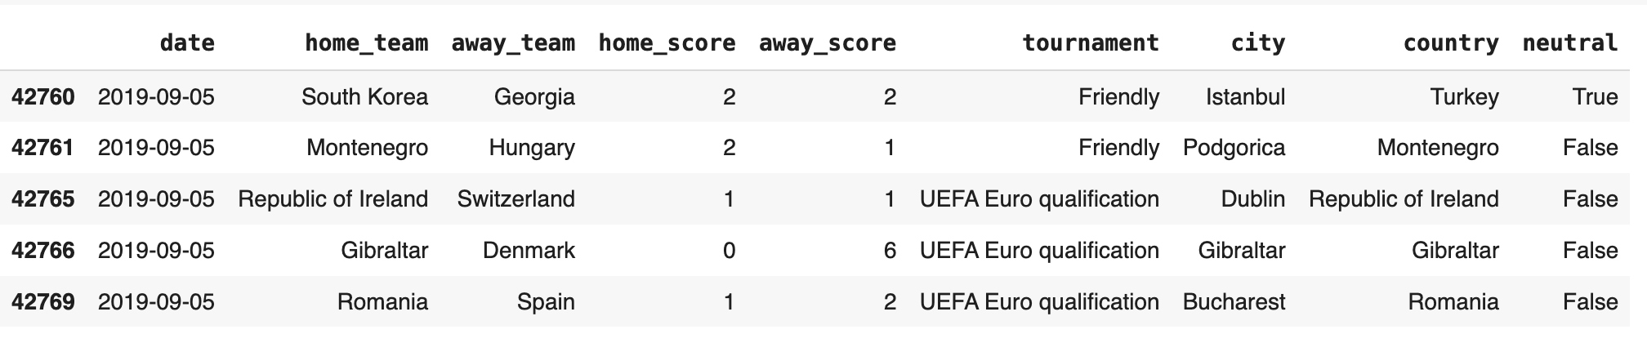
Step1: Data Collection
Data Source & Scoop
Source: Kaggle.com
international matches dataset
Timeframe:
June 13, 2019 - June 13, 2024
Focus: 24 qualifying teams

Slide 5
Step1: Data Collection
Data Preparation
Date filtering
Team filtering
Neutral venue identification Tournament context preservation
Special adjustments for statistical models
Key Preprocessing Steps:

Slide 6
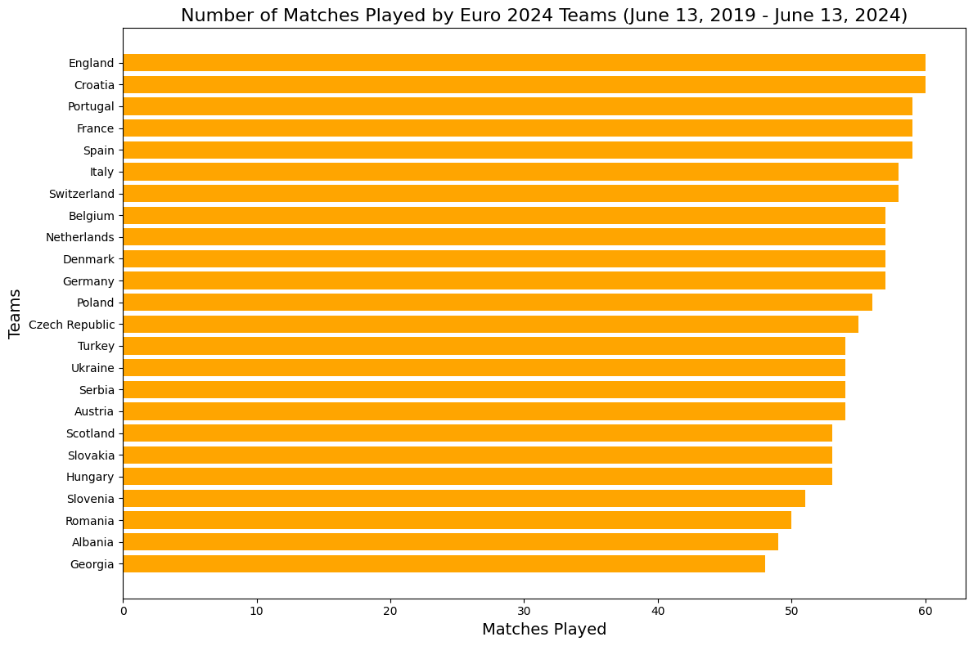
Step2: Exploratory Analysis
Team Activity Analysis
England, Croatia, Portugal most active
less active teams like Georgia and Albania

Slide 7
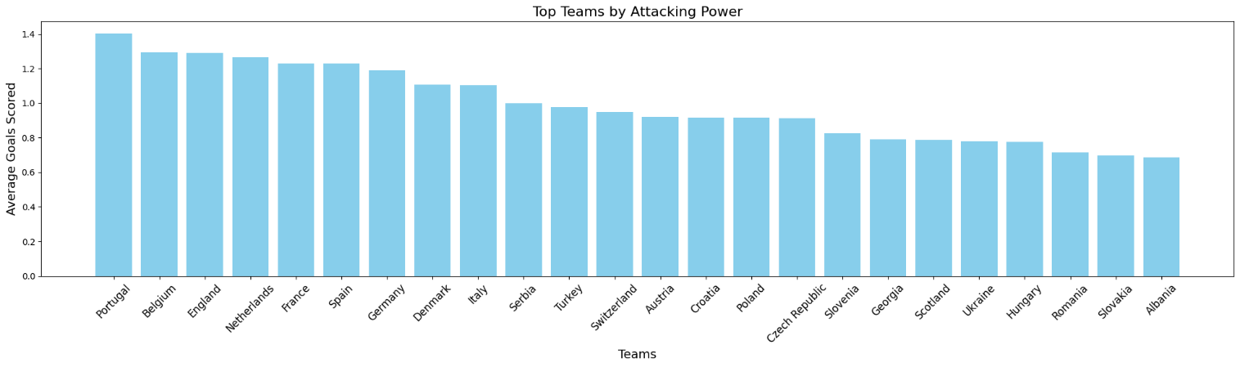
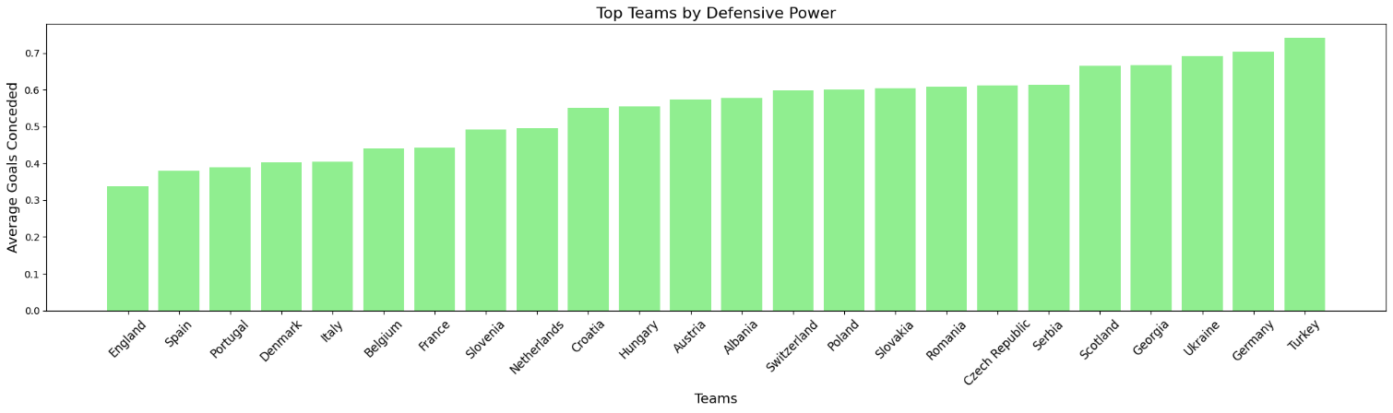
Step2: Exploratory Analysis
Team Performance Metrics
Portugal, Belgium, and England led the pack with high average goals scored, signaling their effectiveness in converting opportunities
England, Spain, and Portugal conceded the fewest goals, emphasizing their ability to maintain defensive stability

Slide 8
Step3: Methodology
Rating system
Custom ELO rating system explanation
Baseline score: 1500
Tournament-specific K-factor
Home-field advantage adjustment
Tournament Simulation
Group stage modeling
Knockout round progression
Tiebreaker handling
Statistical Models
Expected Goals (xG) metric calculation
Poisson distribution implementation
Match outcome simulation process

Slide 9
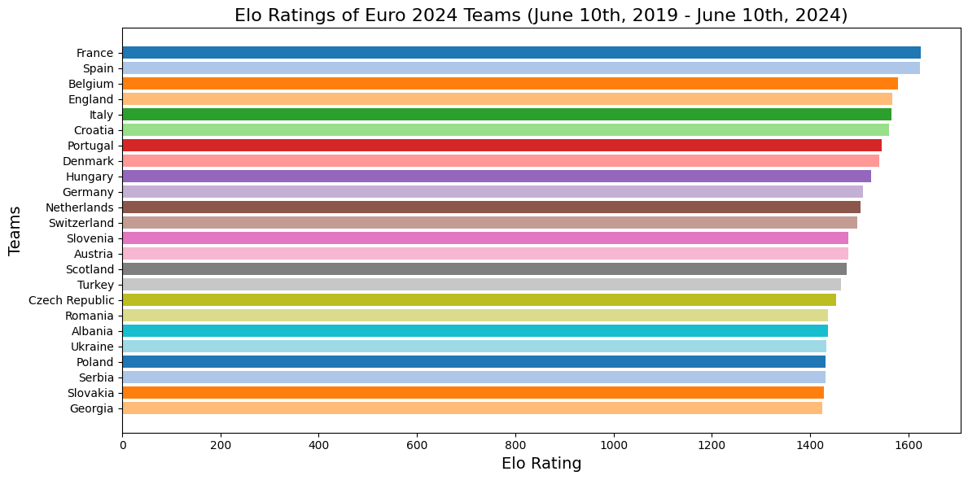
Step4: Results
Team Ranking
Top teams:
France, Spain,
Belgium, England

Slide 10
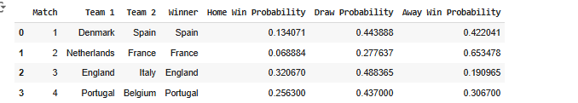
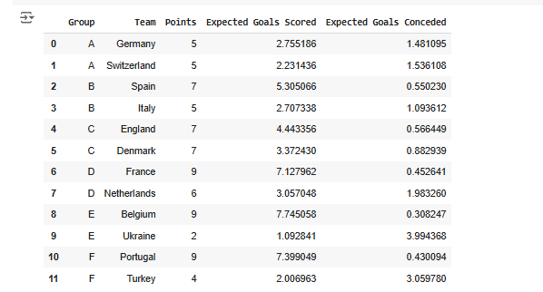

Step4: Results
Tournament Progression
Quarterfinals
knockout stages
Semifinals

Slide 11
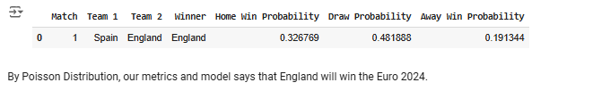
Step4: Results
Final Prediction
England vs Spain final match
Probability breakdown
Comparison with actual outcome (Spain's 2-1 victory)

Slide 12
Step5: Conclusion
Model Performance
01
02
Successful prediction of finalists
Key strengths:
High accuracy in progression prediction
Value for betting markets
Data-driven insights

Slide 13
Step5: Conclusion
Recommendation & Limitations
1
Model applications in betting market
2
Limitations:
Unpredictable factors
Real-time dynamics
3
Final recommendations for stakeholders

Slide 14
Questions & Discussion
Thank you!

